Slide 1

Lecture 5
Express, Express Middleware, PostMan & Sessions

Slide 2

Agenda
What is Express?
What is Express middleware?
Introduction of PostMan
Introduction of Sessions

Slide 3
What is Express?

Slide 4
Express Introduction
Express is a Web Framework built upon Node.js.
Express.js is a fast, flexible and minimalist web framework for Node.js.
It’s effectively a tool that simplifies building web applications and APIs using JavaScript on the server side.
Express is an open-source that is developed and maintained by the Node.js foundation.
Web Applications
Express is a minimal and flexible Node.js web application framework that provides a robust set of features for web and mobile applications.
APIs
With a myriad of HTTP utility methods and middleware at your disposal, creating a robust API is quick and easy.
Performance
Express provides a thin layer of fundamental web application features, without obscuring Node.js features that you know and love.
Middleware
Express is a lightweight and flexible routing framework with minimal core features meant to be augmented through the use of Express middleware modules.

Slide 5
Separation of concerns
Separation of concerns is a software architecture principle which states that one area of a project shall only be responsible for a singular task.
Following this we will look at splitting our express project into 2 main components for now, “controllers” and “routers”
Routers
Routers will dictate what functions are executed when a certain route is hit
Controllers
Controllers are the functions which are called when a route is hit, this is what actually contains the functionality and core logic.

Slide 6
A standard express app
Get started with npm init —y
Install the required packages: npm i express
Create a new file called “server.js”
Create a route on “/” which returns a message
const express = require("express");
const app = express();
app.route("/").get((req, res) => {
res.json({ msg: "Hi!" });
});
app.listen(3000, () => {
console.log("server running on port 3000");
});

Slide 7
Using Routers
Let’s take the original app and make it follow separation of concerns, to start off create a folder called “routes”, this folder would contain all the files pertaining to the routing logic in our express apps.
Create a file called “index.js” in it.
Instantiate a router and move the routing logic from “server.js” to “index.js”
Import the router into “server.js” and link it to the app.
const { Router } = require("express");
const router = Router();
router.route("/").get((req, res) => {
res.json({ msg: "Hi!" });
});
module.exports = { router };
const { router } = require(“./routes”);
…
app.use("/", router);

Slide 8
Using controllers
Let’s now separate the logic of what happens when the route is triggered into a controller, create a folder called “controllers” and create a file called index.js in it.
Move the controller logic for the root route to a function in the controller file
Import the controller into the router and replace the function in “.get” with the one we declared
const getRoot = (req, res) => {
res.json({ msg: "Hi!" });
};
module.exports = { getRoot };
const { Router } = require("express");
const { getRoot } = require("../controller");
const router = Router();
router.route("/").get(getRoot);
module.exports = { router };

Slide 9
Sending Data in POST, PUT and PATCH
when creating our applications we would frequently have to deal with also taking data from the user, the way we do that is by using the “body” property in the request object, “req.body” in our case, would contain the values which were sent to the backend by the user in form of an object.
To actually make use of body in our application, we need to enable the express body parser in the app using “express.json()”
const express = require("express");
const app = express();
app.use(express.json());
app.listen(3000, () => {
console.log("server running on port 3000");
});
After adding the body parser, we would be able to use the “req.body” property in any controller
const fooController = (req, res) => { const { …propNames } = req.body; }

Slide 10
Templating with EJS
<%= %> is used to house JS logic or variables that you want to render on the page.
An EJS file has a “.ejs” extension and follows the same syntax as HTML
01
02
03
04
EJS is a templating engine which is very minimalistic and easy to pick up because of how well it resembles HTML.
The “<% %>” tag is used to house JS logic that we do not want to render but execute, example: for loops, while loops, higher order array methods etc.

Slide 11
Setting up express for EJS
To add EJS template support to express we need to install the “ejs” package, npm i ejs
Create a directory called “views” this is the folder which will contain all the templates
In ”server.js” we need to set the template engine and the assign the directory containing the templates.
To render a template use the “res.render” method where the first param is name of the template and second param is an object containing the variables needed by the template
const express = require("express");
const path = require("path");
const router = require("./routes");
const app = express();
app.set("views", path.join(__dirname, "views"));
app.set("view engine", "ejs");
app.use(express.json());
app.use("/", router);
app.listen(3000, () => {
console.log("server running on port 3000");
});
res.render(“templateName”, { …variables });

Slide 12
Handling Secrets
Working with backend applications we would often find ourselves holding several important secrets and it’s of paramount significance that we keep those secrets secure and unattainable to the regular user, and also don’t accidentally leak them.
Secrets should never be in the actual code, and the code should borrow them from an external file, which is not a part of the actual application, and they can be exposed to the application through a utility.
Traditionally, it is done by adding a “.env” file which contains the secrets.
This also includes making sure that the secrets never make it to any sort of staging environment in our Version Control System. this commonly involves adding the secrets file to “.gitignore”
# SECRETS.ENV file FOO_SECRET = “foo_secret”
BAR_SECRET = “bar_secret”
// config.js const dotenv = require("dotenv");
const path = require("path");
dotenv.config({ path: path.resolve(__dirname, "../") });
module.exports = { ...process.env };

Slide 13


Project
Weather app
Using the OpenMeto and OpenCage API create an app that takes a location and gives the weather forecast the app will have the following paths
“/“ - landing page for the app
“/forecast“ weather forecast for the location passed in query string “q”.

Slide 14
What is Express middleware?

Slide 15
What is Express middleware?
Express is a routing and middleware web framework that has minimal functionality of its own: An Express application is essentially a series of middleware function calls.
Middleware functions are functions that have access to the request object (req), the response object (res), and the next middleware function in the application’s request-response cycle. The next middleware function is commonly denoted by a variable named next.
Middleware functions can perform the following tasks:
Execute any code.
Make changes to the request and the response objects.
End the request-response cycle.
Call the next middleware function in the stack.

Slide 16
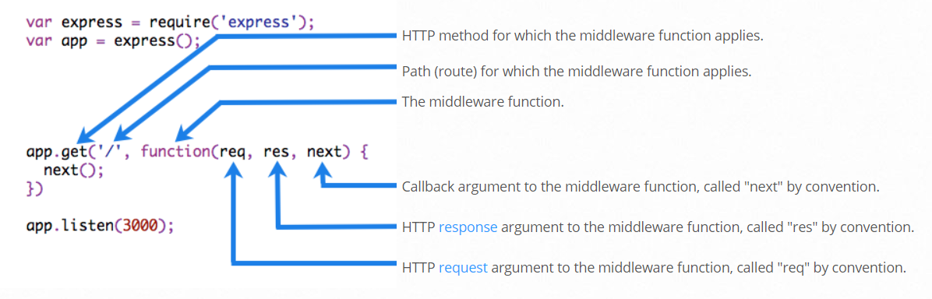
What is Express middleware?
If the current middleware function does not end the request-response cycle, it must call next() to pass control to the next middleware function. Otherwise, the request will be left hanging.
The following figure shows the elements of a middleware function call:
Starting with Express 5, middleware functions that return a Promise will call next(value) when they reject or throw an error. next will be called with either the rejected value or the thrown Error.

Slide 17
What is Express middleware?
An Express application can use the following types of middleware:
Application-level middleware
Router-level middleware
Error-handling middleware
Built-in middleware
Third-party middleware

Slide 18
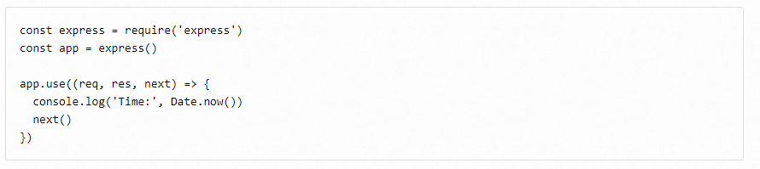
Application-level middleware
Bind application-level middleware to an instance of the app object by using the app.use() and app.METHOD() functions, where METHOD is the HTTP method of the request that the middleware function handles (such as GET, PUT, or POST) in lowercase.
This example shows a middleware function with no mount path. The function is executed every time the app receives a request：

Slide 19
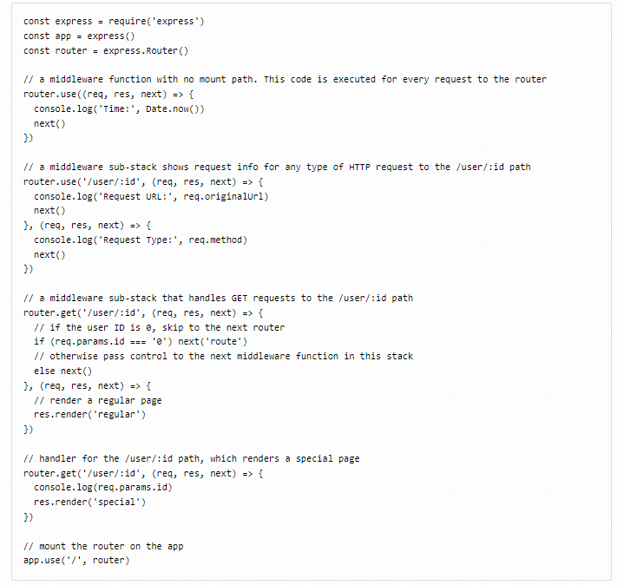

Router-level middleware
Router-level middleware works in the same way as application-level middleware, except it is bound to an instance of express.Router().
Load router-level middleware by using the router.use() and router.METHOD() functions.
The following example code replicates the middleware system that is shown above for application-level middleware, by using router-level middleware:

Slide 20
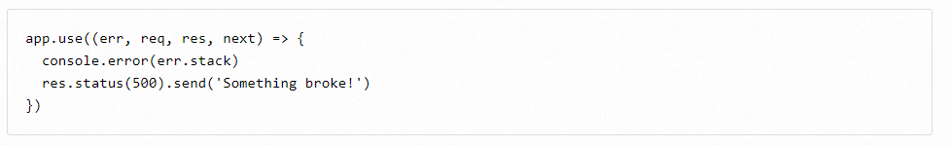
Error-handling middleware
Error-handling middleware always takes four arguments. You must provide four arguments to identify it as an error-handling middleware function. Even if you don’t need to use the next object, you must specify it to maintain the signature. Otherwise, the next object will be interpreted as regular middleware and will fail to handle errors.
Define error-handling middleware functions in the same way as other middleware functions, except with four arguments instead of three, specifically with the signature (err, req, res, next):

Slide 21
Built-in middleware
Starting with version 4.x, Express no longer depends on Connect. The middleware functions that were previously included with Express are now in separate modules;
Express has the following built-in middleware functions:
express.static serves static assets such as HTML files, images, and so on.
express.json parses incoming requests with JSON payloads. NOTE: Available with Express 4.16.0+
express.urlencoded parses incoming requests with URL-encoded payloads. NOTE: Available with Express 4.16.0+

Slide 22
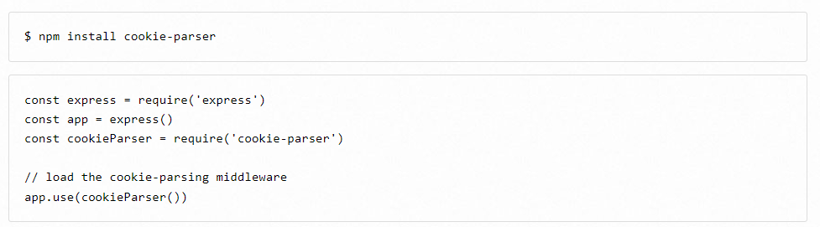
Third-party middleware
Use third-party middleware to add functionality to Express apps.
Install the Node.js module for the required functionality, then load it in your app at the application level or at the router level.
The following example illustrates installing and loading the cookie-parsing middleware function cookie-parser.

Slide 23
Introduction of PostMan

Slide 24
What is PostMan?
Postman is a popular API development tool that simplifies the process of testing, documenting, and sharing APIs. It provides a user-friendly interface for users to send HTTP requests to a server and receive responses.
Postman allows users to create and organize API requests, set up automated testing workflows, and collaborate with team members on API development projects. Additionally, it offers features like environment variables, scripting capabilities, and the ability to mock APIs for testing purposes.
Postman is widely used by developers, testers, and API providers to streamline API development and testing processes.

Slide 25
The concept of Interfaces
When requesting data by calling API, the requested URL address is called the data interface (referred to as the interface). Meanwhile, each interface must have a request method.
For example:
http://www.liulongbin.top:3006/api/getbooks Interface for obtaining book list (GET request)
http://www.liulongbin.top:3006/api/addbook Add book interface (POST request)

Slide 26



Analyze the request process of the interface
The process of requesting interfaces through GET
Data carrier
interactive
GET request
Ajax
Processing requests
Hope to obtain
data from the server
Response
User
Web page
Server

Slide 27
Analyze the request process of the interface
The process of requesting interfaces through POST
Data carrier
interactive
Post request
Ajax
Processing requests
Hope to submit
data to the server
Response
User
Web page
Server

Slide 28

Interface testing tools
What is an interface testing tools
In order to verify whether the interface can be accessed normally, we often need to use interface testing tools to test the data interface. As what we have mentioned, PostMan is one of the example, a popular interface testing tools.
Benefit: Interface testing tools allow us to call and test interfaces without writing any code.
PostMan

Slide 29
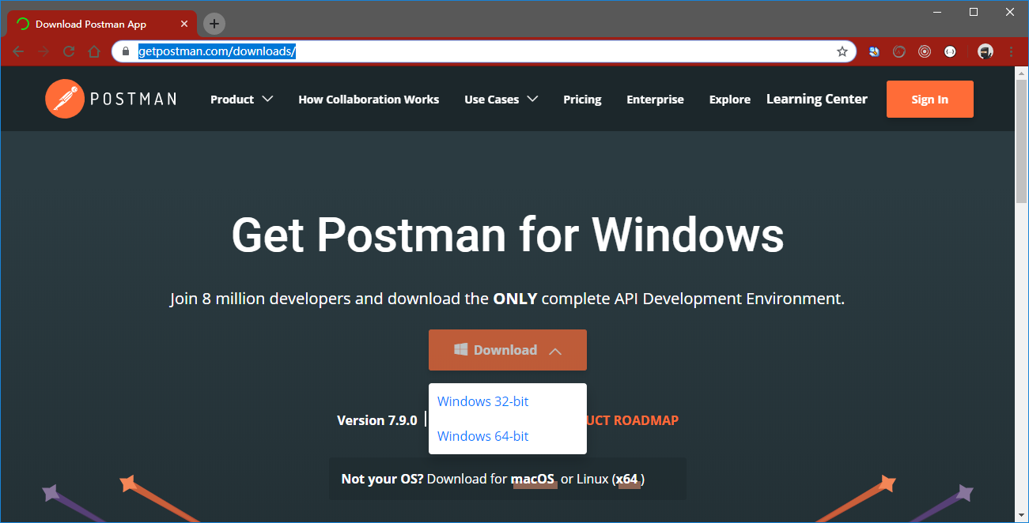
Interface testing tools
Download and install PostMan
Visit the official download website of PostMan https://www.getpostman.com/downloads/ After downloading the required installation program, simply install it directly.

Slide 30
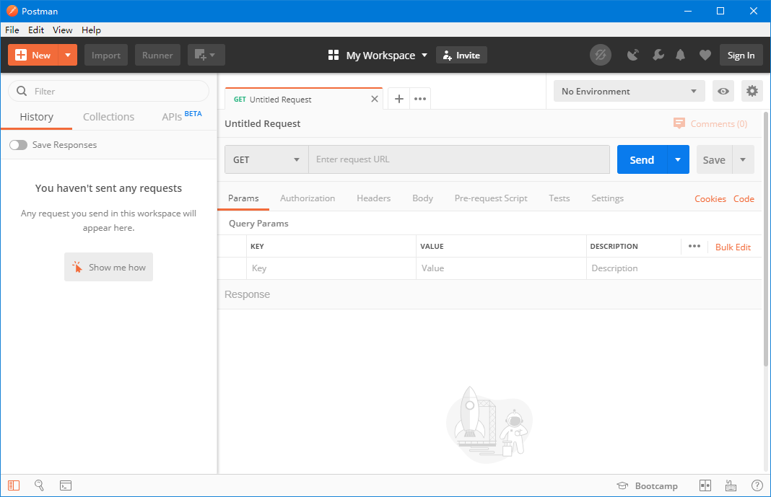
Interface testing tools
Understand the components of the PostMan interface
The components of the PostMan interface, from top to bottom and from left to right, are:
menu bar
Toolbar
Left History and Collection Panel
Request tab
Request Address Area
Request parameter area
Response result area
status bar

Slide 31
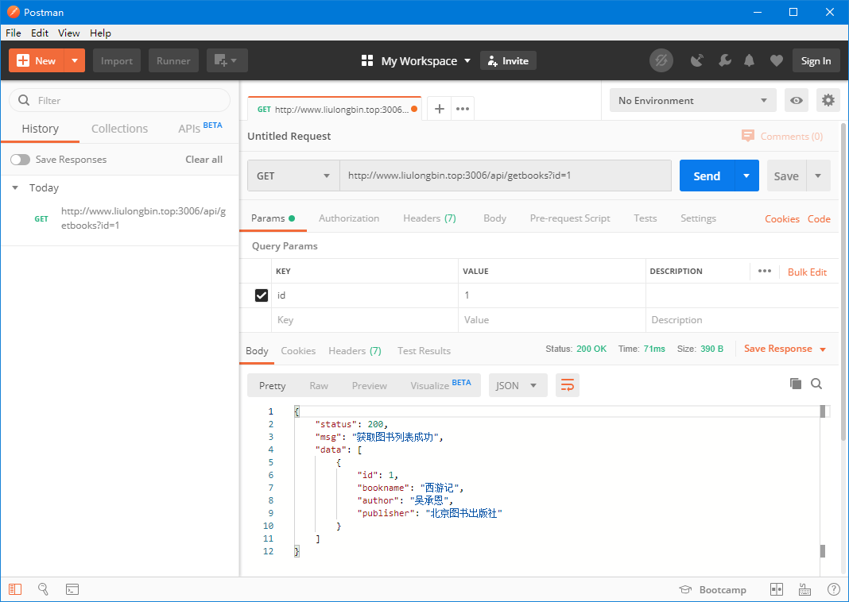
Using PostMan to test GET request
Steps:
Choose the method of request
Fill in the requested URL address
Fill in the requested parameters
Click the Send button to initiate a GET request
View the results of server response

Slide 32
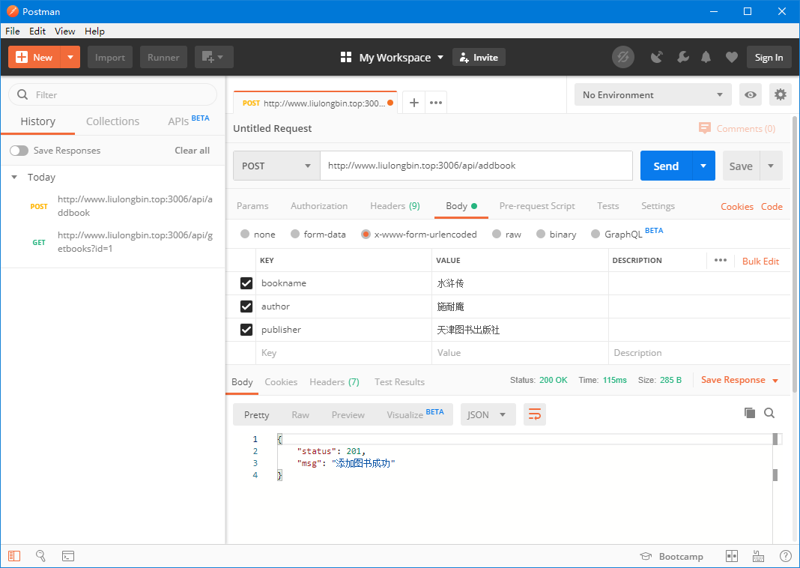
Using PostMan to test POST request
Steps:
Choose the method of request
Fill in the requested URL address
Select the Body panel and check the data format
Fill in the data to be sent to the server
Click the Send button to initiate a POST request
View the results of server response

Slide 33
Introduction of Sessions

Slide 34
What is a Session?
Node.js is an emerging technology, and with Express it become insanely powerful. We can use Node.js with Express to manage sessions. In this tutorial, you will learn to manage sessions including setting up sessions, saving data in sessions and fetching data from sessions.
A website uses HTTP protocol to transfer information between a client and a server. This HTTP protocol is a stateless protocol, where the server won’t have a status of communication and it doesn’t keep track of requests and responses made from a client to the server. In terms of security, it is really better to track the user request to know how many times a user requests or which data a user wants to access, etc.
To make the HTTP protocol stateful from stateless, we have sessions.
A session is a mechanism that allows a web server to store information about a user's interaction with a website or web application. It enables the server to identify and authenticate users across multiple requests and maintain stateful information during their session.

Slide 35
Why Use Sessions?
Sessions are crucial for managing user authentication and maintaining user-specific data in web applications.
Some common use cases for sessions include:
User Authentication: Sessions enable user login and authentication, allowing users to access protected resources and perform actions within the application.
Access Control: Sessions help enforce access control by storing user roles or permissions and validating them on subsequent requests.
Personalized User Experiences: Sessions enable storing user preferences, settings, and other session-specific data to deliver personalized experiences.

Slide 36

Setting Up Express.js Session
Often when building out our APIs we want to restrict access to certain regions of the API to a certain area, sometimes it’s just that we need to know which user is logged in and other times we also want to give permissioned access to certain areas, for example only staff users with manager level access shall be allowed to access
Step 1: Install Dependencies
Start by creating a new Express.js project and navigating to its root directory in the terminal. Install the required dependencies using npm or yarn:

Slide 37
Setting Up Express.js Session
Step 2: Configure Express.js Session Middleware
Create a new file called app.js (or index.js) in the project's root directory and import the necessary modules:

Slide 38
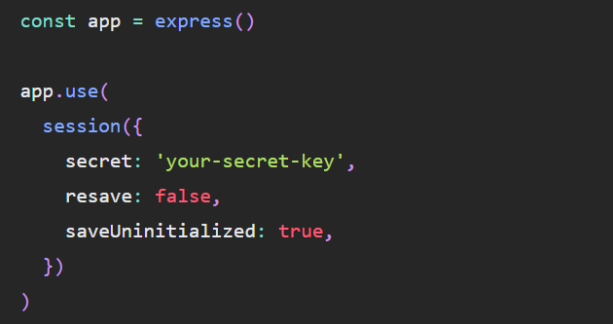
Setting Up Express.js Session
Step 2: Configure Express.js Session Middleware
Configure the session middleware by setting up a session store and specifying session options:
In the code above, we use the secret option to provide a random string that is used to sign the session ID cookie. It is recommended to store this secret key securely and not commit it to version control. The resave option controls whether the session should be saved to the store on every request, while the saveUninitialized option determines whether an uninitialized session should be saved to the store.

Slide 39
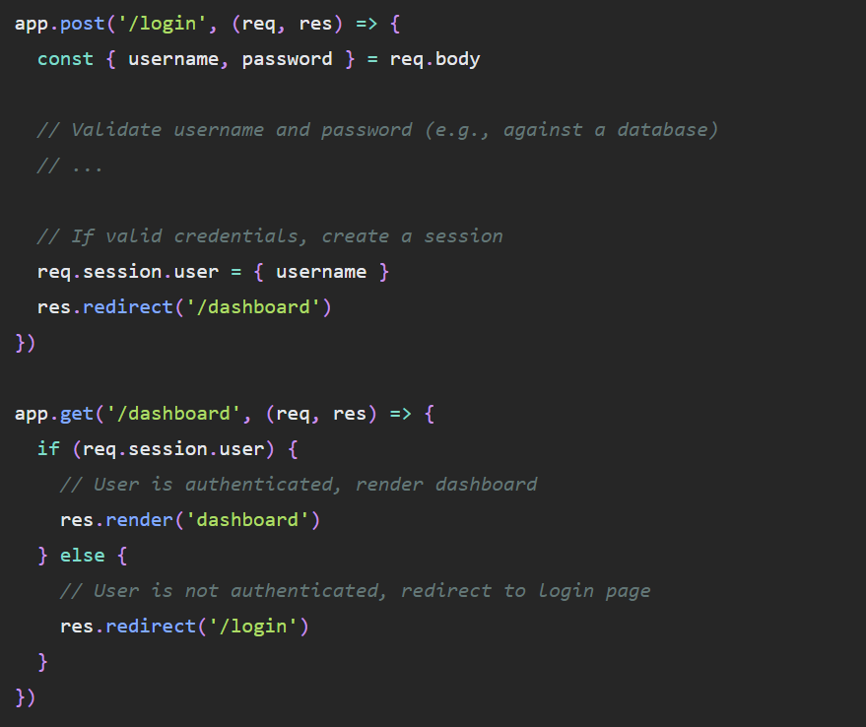
Setting Up Express.js Session
Step 3: Implement Session-Based Authentication
Now that session middleware is set up, we can implement session-based authentication. Let's create a simple authentication flow using username and password:
In the code snippet above, we handle a POST request to /login where we validate the username and password against a database. If the credentials are valid, we create a session by storing the user object in req.session.user. In the subsequent GET request to /dashboard, we check if the user is authenticated by verifying the presence of req.session.user. If the user is authenticated, we render the dashboard; otherwise, we redirect them to the login page.

Slide 40
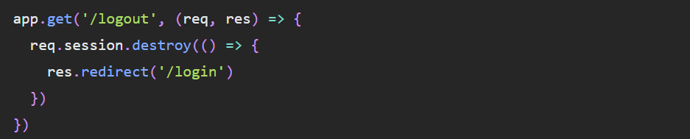
Setting Up Express.js Session
Step 4: Destroying a Session
To implement a logout feature and destroy the session, we can add a /logout route:
The req.session.destroy() method removes the session and associated data from the session store. After destroying the session, we redirect the user back to the login page.

Slide 41
Summary of Session
We explored how to implement session management in Express.js using the express-session middleware.
Sessions are essential for managing user authentication, access control, and delivering personalized user experiences in web applications.
By following the steps outlined in this guide, you can set up and leverage session management in your Express.js projects effectively.

